Slide 1
LIBRARY MANAGEMENT SYSTEM USING JAVA FOR WEB DEVELOPMENT
G.Tejaswi(192211748)
P.VENKATRATHNAM(192211380)

Slide 2
INTRODUCTION
The Library Management System is a web-based application developed using Java
technologies. It aims to automate the management of library operations such as
cataloging books, tracking borrowed books, and managing user accounts.
Significance: Efficient library management is crucial for educational institutions, public libraries, and private collections. An automated system reduces manual effort, minimizes errors, and provides easy access to library resources, improving overall user experience and operational efficiency.
Objectives:
Objective 1: To develop a user-friendly interface for library users to search, borrow, and return books efficiently.
Objective 2: To implement a robust user authentication system to manage user accounts securely.
Objective 3: To provide an administrative dashboard for librarians to manage book inventory, user records, and track borrowing activities.
Objective 4: To ensure data integrity and consistency through a well-designed database system.
Objective 5: To offer scalability and flexibility, allowing future enhancements and integration with other systems or technologies.

Slide 3
PROBLEM STATEMENT
Current Issues:
Manual Processes: Many libraries still rely on manual processes for book checkouts and returns, leading to inefficiencies and errors.
Limited Access: Traditional systems often require physical presence in the library, limiting user access to library resources.
Data Management Challenges: Maintaining accurate records of book inventories, user information, and transaction histories can be cumbersome and prone to errors.
Lack of Real-Time Updates: Existing systems may not provide real-time updates on book availability, leading to discrepancies and user frustration.
Inadequate User Experience: Outdated interfaces and limited online functionalities result in poor user experience and engagement.
Need for the Project:
Automation and Efficiency: The proposed system will automate routine tasks, reducing manual workload and minimizing errors.
24/7 Accessibility: A web-based platform allows users to access library resources anytime and from anywhere, enhancing convenience.
Improved Data Accuracy: Centralized data management ensures accurate and up-to-date records of all library transactions and inventories.
Real-Time Information: Users and administrators will benefit from real-time updates on book availability and user activities.
Enhanced User Interaction: A modern, intuitive interface will provide a better user experience, encouraging more engagement with the library’s resources.

Slide 4
PROJECT SCOPE
Features:
User Registration and Authentication:
Secure registration and login for library patrons and staff.
Role-based access control for different user types (e.g., patrons, librarians, administrators).
Book Search and Catalog:
Comprehensive book catalog with search functionality by title, author, genre, and more.
Detailed book information, including availability status and location.
Borrowing and Returning Books:
Streamlined process for checking out and returning books.
Automatic due date reminders and overdue notifications.
Administration and Management:
Tools for managing book inventory, including adding, updating, and removing books.
User management features, such as viewing borrowing history and managing fines.
Generation of reports and analytics for library usage and trends.
Limitations:
Initial Data Entry: Significant time and effort required for entering existing book inventories into the new system.
User Training: Users and staff may need training to adapt to the new system.
Internet Dependency: The system relies on internet connectivity, which can be a constraint in areas with limited access.
Scalability Issues: Initial versions may have limitations in handling very large libraries with extensive collections.
Customization Needs: Libraries with unique workflows may require additional customization beyond the initial scope.

Slide 5
SYSTEM ARCHITECTURE
Components:
User Interface:
Web Browser: Users interact with the system through a web browser, accessing the library's web application.
Frontend:
HTML/CSS/JavaScript: The user interface is built using standard web technologies to ensure compatibility and responsiveness.
Frameworks (e.g., React): Enhances the interactivity and user experience by creating dynamic web pages.
Backend:
Application Server (e.g., Spring Boot): Manages business logic, processes user requests, and communicates with the database.
RESTful APIs: Provides endpoints for frontend interaction, handling operations like user authentication, book searches, and transactions.
Database:
Relational Database (e.g., MySQL): Stores all data related to users, books, transactions, and administrative records.
Database Management System: Ensures data integrity, security, and efficient retrieval of information.

Slide 6
TECHNOLOGY STACK
Frontend:
HTML: Structure of the web pages.
CSS: Styling and layout for a visually appealing interface.
JavaScript: Adds interactivity and dynamic content to the web pages.
React: A JavaScript library for building user interfaces, allowing for efficient and modular development.
Backend:
Java (Spring Boot): A powerful, production-ready backend framework for building RESTful web services and handling business logic.
Node.js: An alternative backend technology used for handling asynchronous operations and building scalable network applications (if applicable).
Database:
MySQL: A relational database management system used for structured data storage, ensuring data integrity and efficient queries.
MongoDB: A NoSQL database used for storing unstructured data, providing flexibility and scalability (if applicable).
Other Tools:
Git: Version control system for tracking changes and collaborating on code development.
Docker: Containerization tool for creating, deploying, and running applications in isolated environments.
Postman: API development and testing tool to ensure backend endpoints work as expected.
Maven/Gradle: Build automation tools for managing project dependencies and compiling code.
JUnit: Testing framework for writing and running test cases to ensure code reliability and correctness.

Slide 7
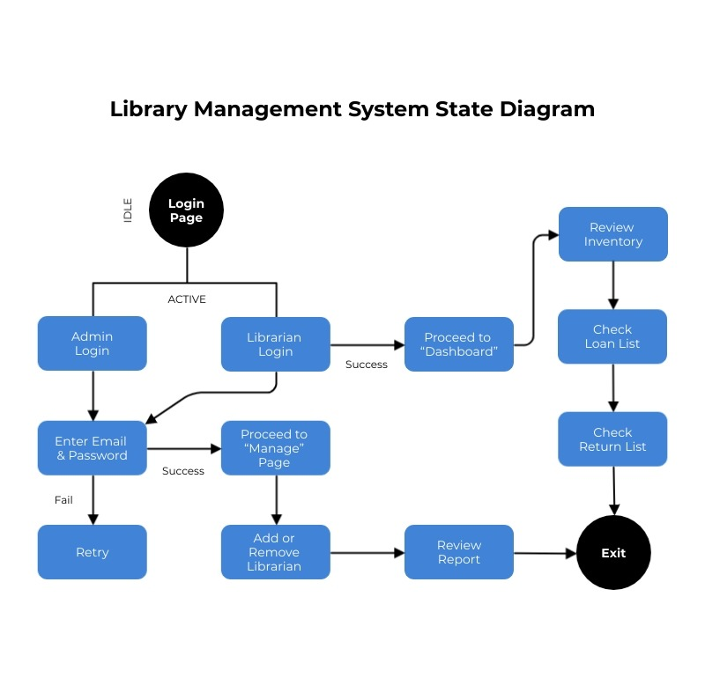
USER INTERFACE DESIGN

Slide 8
IMPLEMENTATION
Frontend Implementation:
Development Tools and Frameworks:
HTML/CSS: Used for the structure and styling of web pages.
JavaScript: Adds interactivity and dynamic content.
React: A JavaScript library for building responsive and efficient user interfaces with reusable components.
Process:
Component-Based Architecture: Utilized React components to create modular and reusable UI elements.
State Management: Managed the application state using React's state and context API.
Routing: Implemented React Router for seamless navigation between pages.
API Integration: Used Axios for making HTTP requests to the backend, facilitating data retrieval and interaction with the server.
Backend Implementation:
Development Tools and Frameworks:
Java (Spring Boot): Selected for its robustness and comprehensive ecosystem for building web applications.
RESTful APIs: Designed RESTful endpoints to handle client requests and perform CRUD operations on the database.
Process:
Controller Layer: Handled incoming HTTP requests, mapped them to appropriate service methods, and returned responses.
Service Layer: Encapsulated business logic and interacted with the repository layer for database operations.
Repository Layer: Used Spring Data JPA to interact with the MySQL database, enabling efficient data access and manipulation.
Security: Implemented JWT-based authentication for secure user login and role-based access control.
Database Design:
Database Management System:
MySQL: Chosen for its reliability, performance, and ease of use for managing relational data.
ER Diagram:
(Replace with actual ER diagram)Entities and Relationships:
Users:
Attributes: user_id, username, password, role
Books:
Attributes: book_id, title, author, genre, availability
Transactions:
Attributes: transaction_id, user_id, book_id, borrow_date, return_date
Relationships:
A user can borrow multiple books (one-to-many relationship between Users and Transactions).
A book can be borrowed multiple times (one-to-many relationship between Books and Transactions).

Slide 9
KEY FEATURES DEMONSTRATION
Feature 1: User Registration and Login
Description: Enables users to securely register, providing necessary details, and login to access the library system with role-based authentication.
Demo: Screenshots showcasing the registration form and login page, ensuring secure access management.
Feature 2: Book Search and Catalog
Description: Facilitates easy navigation through a comprehensive catalog, allowing users to search books by title, author, or genre, and view availability status and detailed information.
Demo: Screenshots demonstrating search functionality and catalog interface, ensuring efficient browsing and selection.
Feature 3: Borrowing and Returning Books
Description: Supports seamless borrowing and returning processes, displaying borrowed books with due dates, allowing renewals, and sending notifications for overdue items.
Demo: Screenshots illustrating borrowing and returning workflows, ensuring user-friendly transaction management.
Feature 4: Administration and Management
Description: Empowers administrators with tools to manage book inventory, add new books, update details, manage user accounts, and generate reports for library operations.
Demo: Screenshots of the admin panel displaying management features, ensuring efficient oversight and reporting capabilities.

Slide 10
CHALLENGES FACED
Technical Challenges:
Integration of Frontend with Backend:
Ensuring seamless communication and data exchange between React frontend and Spring Boot backend.
Concurrency and Transaction Management:
Handling concurrent book borrowing and returning requests to maintain data consistency.
Security Implementation:
Implementing JWT-based authentication and secure password storage to protect user data.
Database Optimization:
Optimizing database queries for efficient data retrieval and management, particularly with large datasets.
UI/UX Design and Responsiveness:
Ensuring a responsive and intuitive user interface across different devices and screen sizes.
Solutions:
RESTful API Design:
Developed well-defined API endpoints following REST principles for smooth frontend-backend communication.
Transaction Management:
Implemented transaction strategies in Spring Boot to manage concurrent operations and maintain data integrity.
Security Frameworks:
Integrated Spring Security to enforce authentication and authorization, ensuring secure access to system resources.
Database Indexing:
Utilized indexing and query optimization techniques in the database to improve performance and scalability.
Responsive Design:
Employed CSS frameworks and media queries in React to achieve responsiveness and enhance user experience.

Slide 11
TESTING AND VALIDATION
Testing Methods:
Unit Testing: Ensured individual components like API endpoints and service methods function correctly.
Integration Testing: Validated interactions between frontend (React) and backend (Spring Boot).
End-to-End (E2E) Testing: Verified complete workflows from user login to book borrowing and return.
Security Testing: Conducted assessments to identify and mitigate potential vulnerabilities.
Results:
High Code Coverage: Achieved over 80% coverage in critical functionalities.
Seamless Integration: Confirmed smooth data exchange between frontend and backend.
Functional Workflow: Successfully validated user journeys without critical failures.
Security Assurance: Identified and addressed vulnerabilities early in development.

Slide 12
FUTURE ENHANCEMENTS
Potential Improvements:
Advanced Search Filters: Introduce options like publication year and language for precise book searches.
Mobile Application: Develop a dedicated app for improved accessibility on smartphones and tablets.
Recommendation System: Implement machine learning for personalized book recommendations.
Enhanced Reporting: Expand analytics to cover user activity and popular books.
User Feedback System: Incorporate user ratings and suggestions for library improvements.
Digital Resources Integration: Add access to e-books, audiobooks, and online journals.
Multi-language Support: Enable usage in multiple languages for broader accessibility.
Scalability:
Database Optimization: Optimize queries and indexing to handle large datasets efficiently.
Microservices Architecture: Transition for improved modularity and scalability.
Cloud Deployment: Utilize cloud platforms for scalable infrastructure and high availability.
Load Balancing: Implement load balancing for distributing traffic across servers.
Caching Mechanisms: Use caching (e.g., Redis) to enhance performance for frequently accessed data.

Slide 13
CONCLUSION
Summary:
Developed a comprehensive Library Management System using Java (Spring Boot) and React.
Key features include user authentication, book cataloging, borrowing/returning management, and admin tools.
Testing methods included unit, integration, E2E, and security testing for robust functionality.
Achievements:
Successfully delivered a user-friendly system meeting library management needs effectively.
Achieved high reliability with extensive testing and secure user data management.
Positive user feedback highlighted system usability and efficiency.
Acknowledgements:
Thanks to the development team for their dedication and effort in project completion.
Appreciation to mentors and advisors for valuable guidance throughout development.
Gratitude to library staff and users for their input and support during system testing and refinement.

